Slide 1
Concepts
Introduction to HTML

Slide 2
Project Objectives
Describe the Internet and its associated key terms
Describe the World Wide Web and its associated key terms
Identify the types and purposes of Web sites
Discuss Web browsers and identify their purpose

Slide 3
Project Objectives
Define Hypertext Markup Language (HTML) and the standards used for Web development
Define Dynamic Hypertext Markup Language (DHTML) and describe its relationship to HTML
Define Extensible Hypertext Markup Language (XHTML) and describe its relationship to HTML
Describe tools used to create HTML documents

Slide 4
Project Objectives
Discuss the five phases of the Web development life cycle
Describe Web site structures and the purpose of each structure
Describe the importance of testing throughout the Web development life cycle

Slide 5
What Is the Internet?
The Internet is a worldwide collection of computer networks that links together millions of computers used by businesses, the government, educational institutions, organizations, and individuals using modems, telephone lines, television cables, and other communications devices and media
A network is a group of two or more computers that are connected together to share resources and information
The Internet backbone is a collection of high-speed data lines that connect major computer systems located around the world
An Internet Service Provider (ISP) is a company that has a permanent connection to the Internet backbone

Slide 6
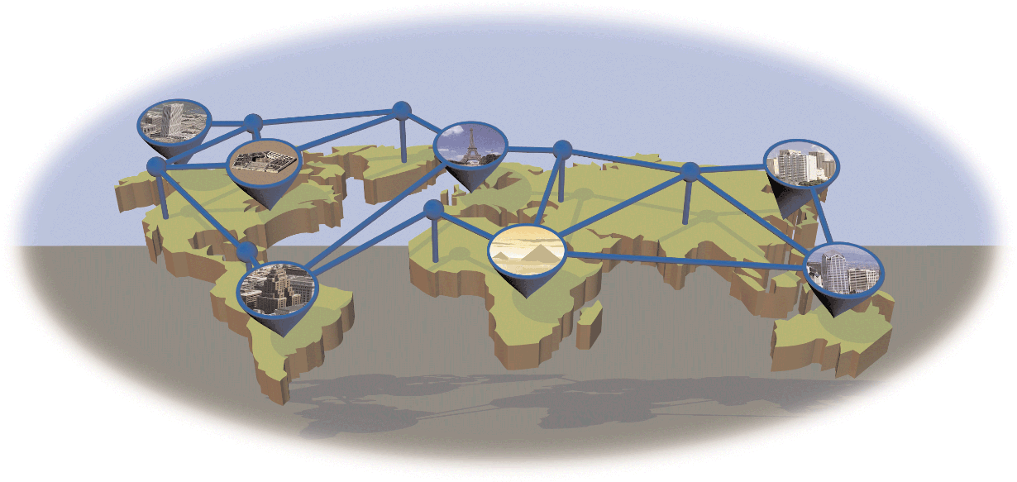
What Is the Internet?

Slide 7
What Is the World Wide Web?
The World Wide Web, also called the Web, is the part of the Internet that supports multimedia and consists of a collection of linked documents.
Hypertext Transfer Protocol (HTTP) is a set of rules for exchanging text, graphics, sound, and other multimedia files
Web pages are pages of information on the Web
A Web site is a related collection of Web pages
A home page is the first document users see when they access a Web site

Slide 8
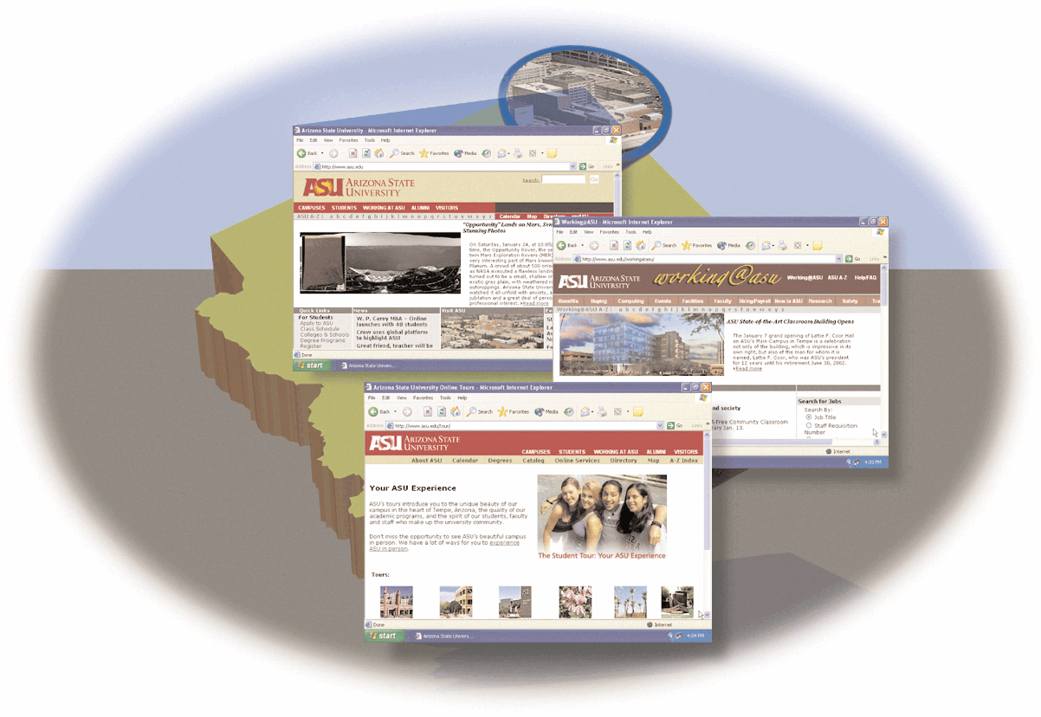
What Is the World Wide Web?

Slide 9
Web Servers
Web pages are stored on a Web server, or host, which is a computer that stores and sends (serves) requested Web pages and other files
Publishing is copying Web pages and other files to a Web server

Slide 10
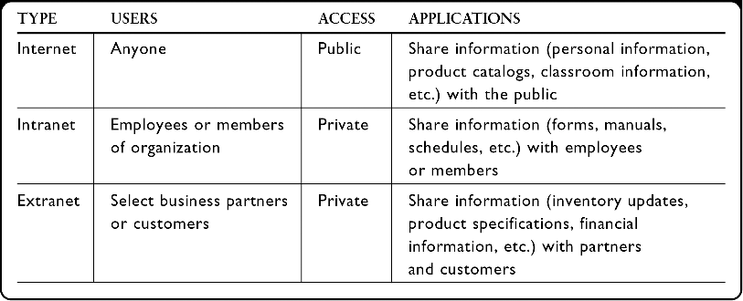
Web Site Types and Purposes
Electronic commerce (e-commerce) is the buying and selling of goods and services on the Internet

Slide 11
Web Browsers
A Web browser, also called a browser, is a program that interprets and displays Web pages and enables you to view and interact with a Web page
  Google Chrome and Mozilla
A Uniform Resource Locator (URL) is the address of a document or other file accessible on the Internet
  http://www.scsite.com/html3e/index.htm
A hyperlink, also called a link, is an element used to connect one Web page to another

Slide 12
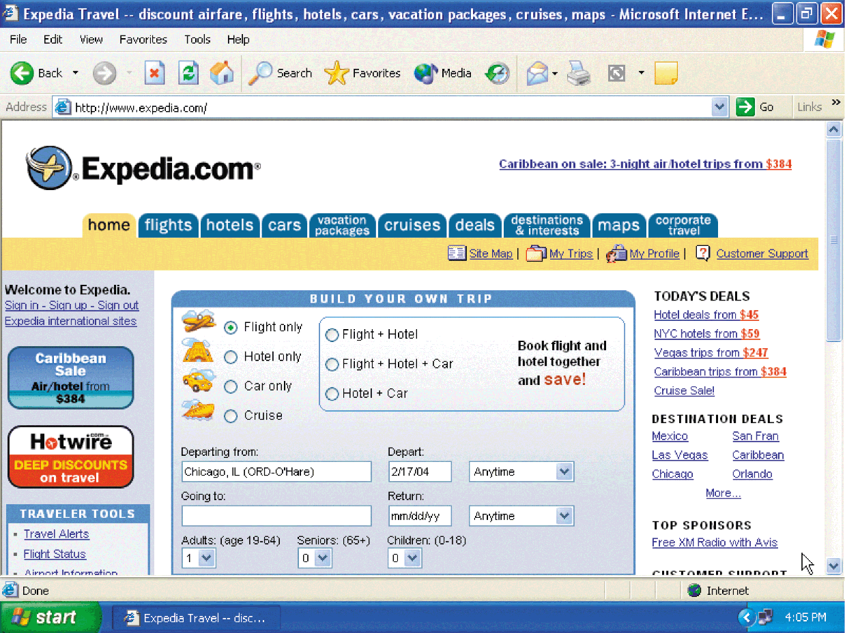
Web Browsers

Slide 13
What Is Hypertext Markup Language?
Web pages are created using Hypertext Markup Language (HTML), which is the authoring language used to create documents on the World Wide Web
HTML uses a set of special instructions called tags or markup to define the structure and layout of a Web document and specify how the page is displayed in a browser
HTML is platform independent, meaning you can create, or code, an HTML file on one type of computer and then use a browser on another type of computer to view that file as a Web page

Slide 14
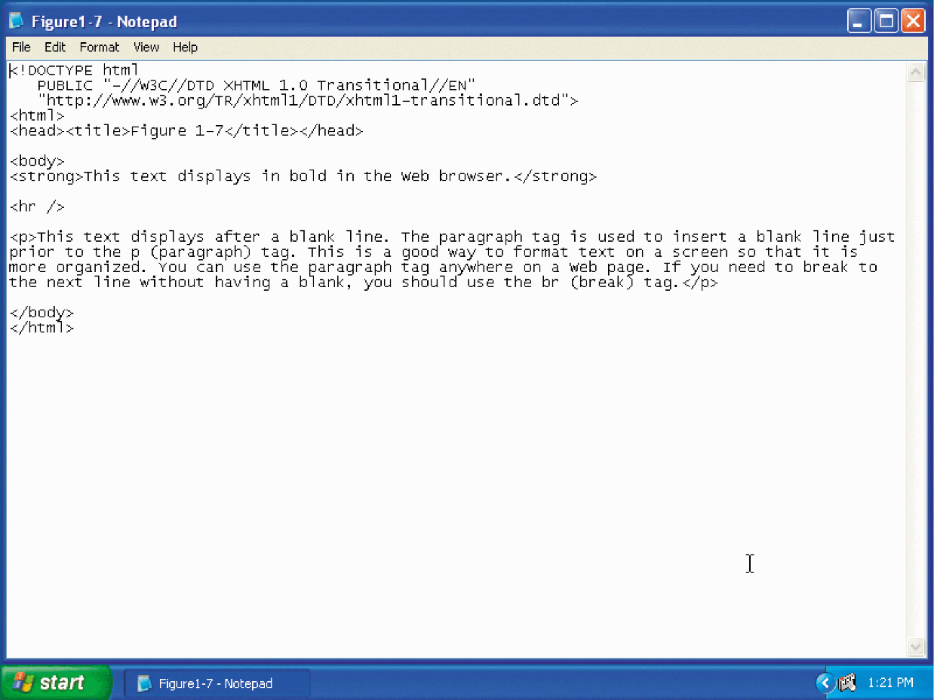
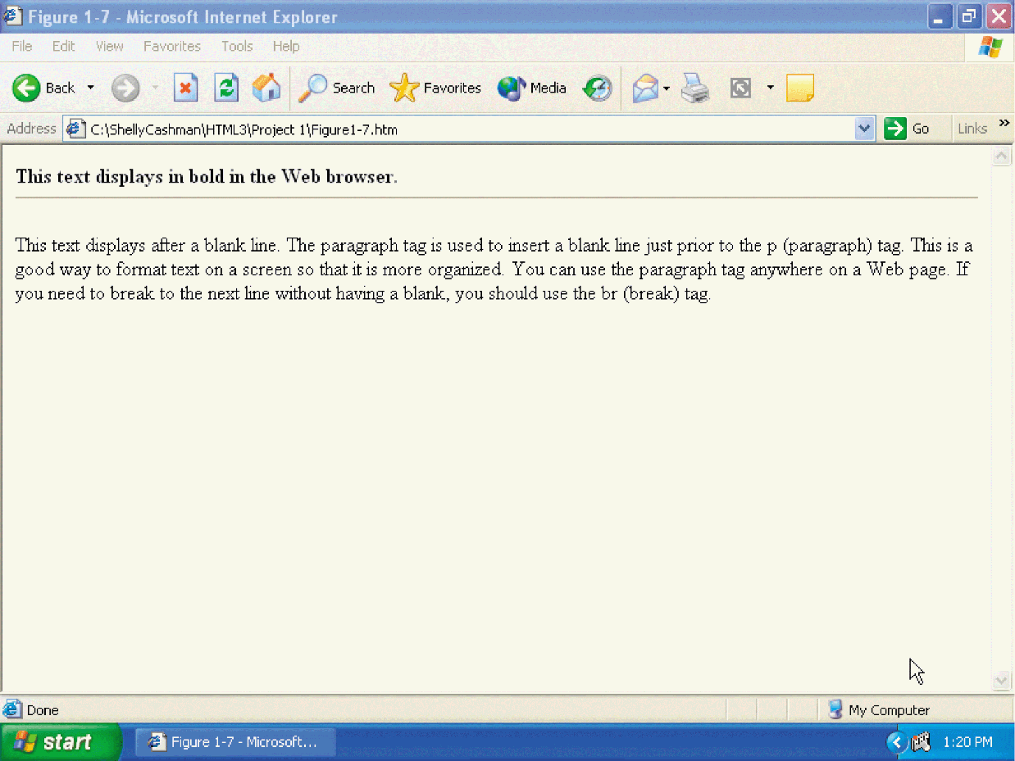
What Is Hypertext Markup Language?

Slide 15
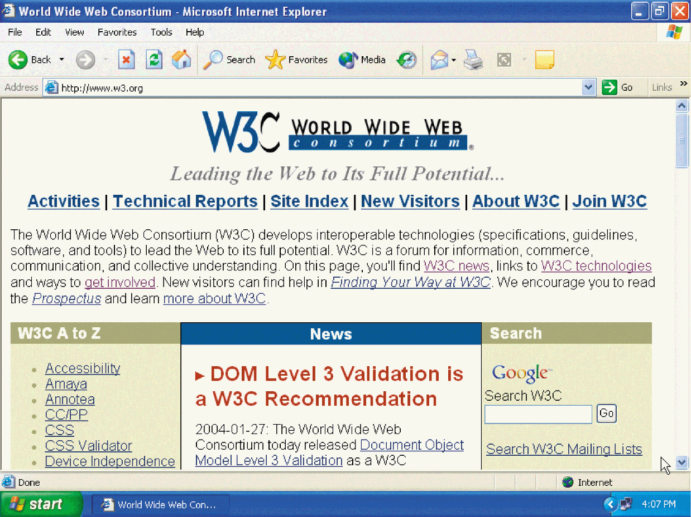
HTML History
The World Wide Web Consortium (W3C) is an industry consortium that seeks to promote standards for the evolution of the Web and Web technologies
  http://www.w3.org

Slide 16
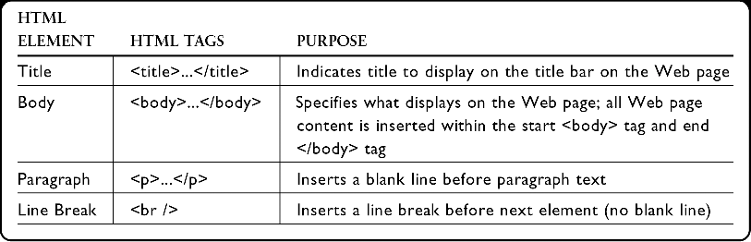
HTML Elements

Slide 17
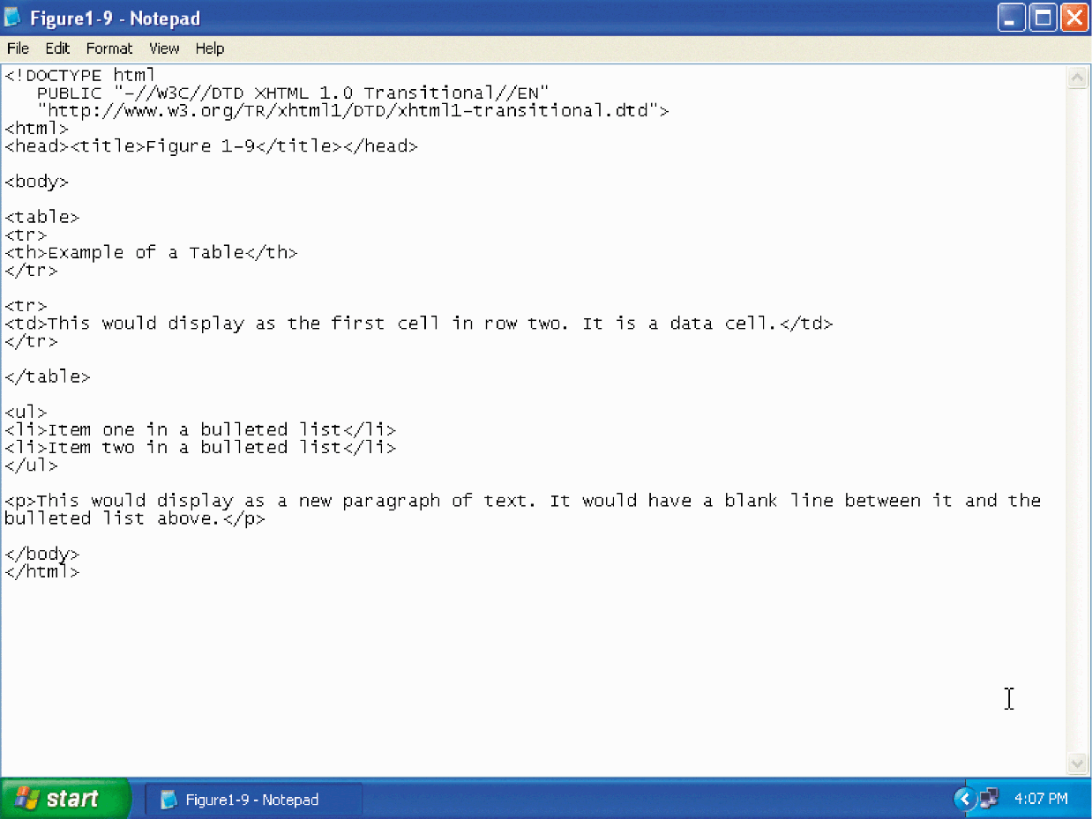
HTML Coding Practices

Slide 18
HTML Versions
HTML has gone through several versions, each of which expands the capabilities of HTML
The most recent version of HTML is HTML 4.01

Slide 19
Dynamic HTML (DHTML)
Dynamic HTML (DHTML) is a term that describes a combination of HTML tags, cascading style sheets (CSS), and a scripting language such as JavaScript. DHTML allows users to create interactive, animated Web pages

Slide 20
Extensible Hypertext Markup Language (XHTML)
Extensible Markup Language (XML) is a markup language that uses tags to describe the structure and content of a document, not the format
Extensible Hypertext Markup Language (XHTML) is a reformulation of HTML so it conforms to Extensible Markup Language (XML) rules

Slide 21
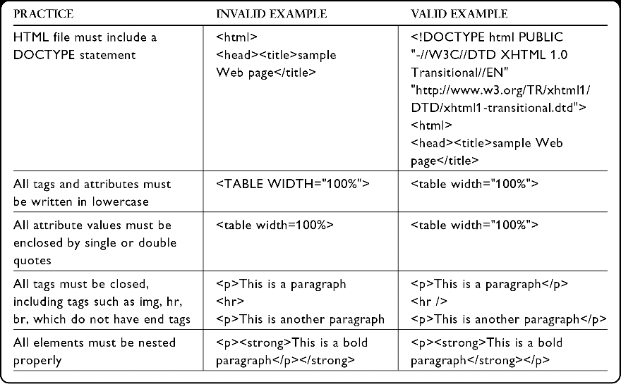
Extensible Hypertext Markup Language (XHTML)

Slide 22
Tools for Creating HTML Documents
A text editor is a program that allows a user to enter, change, save, and print text, such as HTML
An HTML editor is a program that provides basic text-editing functions, as well as more advanced features, such as color-coding for various HTML tags, menus to insert HTML tags, and spell checkers
A WYSIWYG editor is a program that provides a graphical user interface that allows a developer to preview the Web page during its development

Slide 23
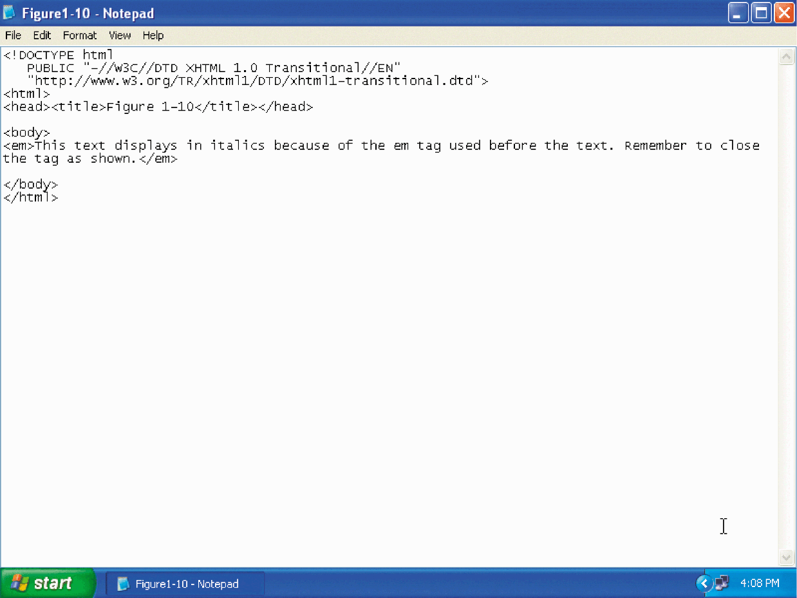
Tools for Creating HTML Documents

Slide 24
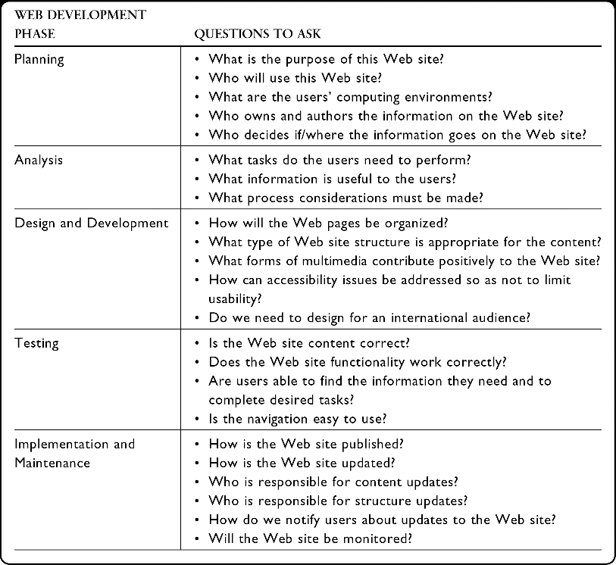
Web Development Life Cycle

Slide 25
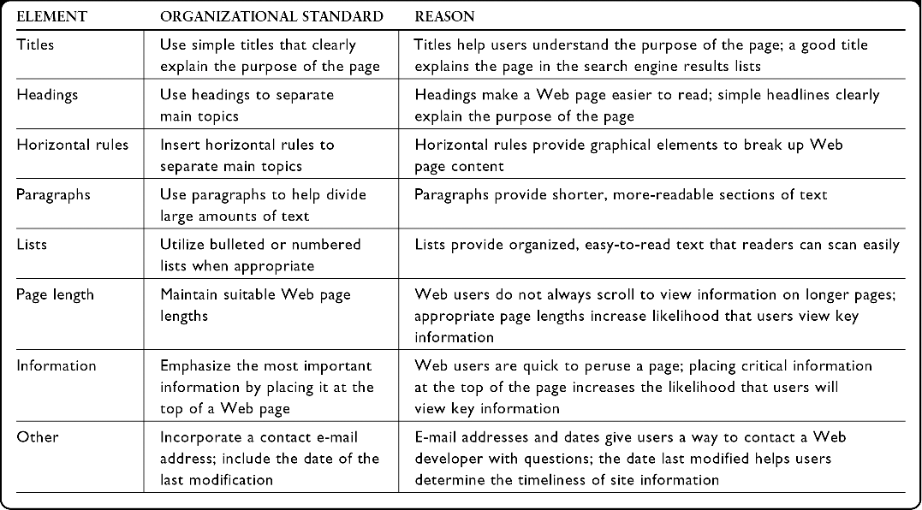
Web Site Design and Development

Slide 26

Web Site Design and Development
A linear Web site structure connects Web pages in a straight line

Slide 27
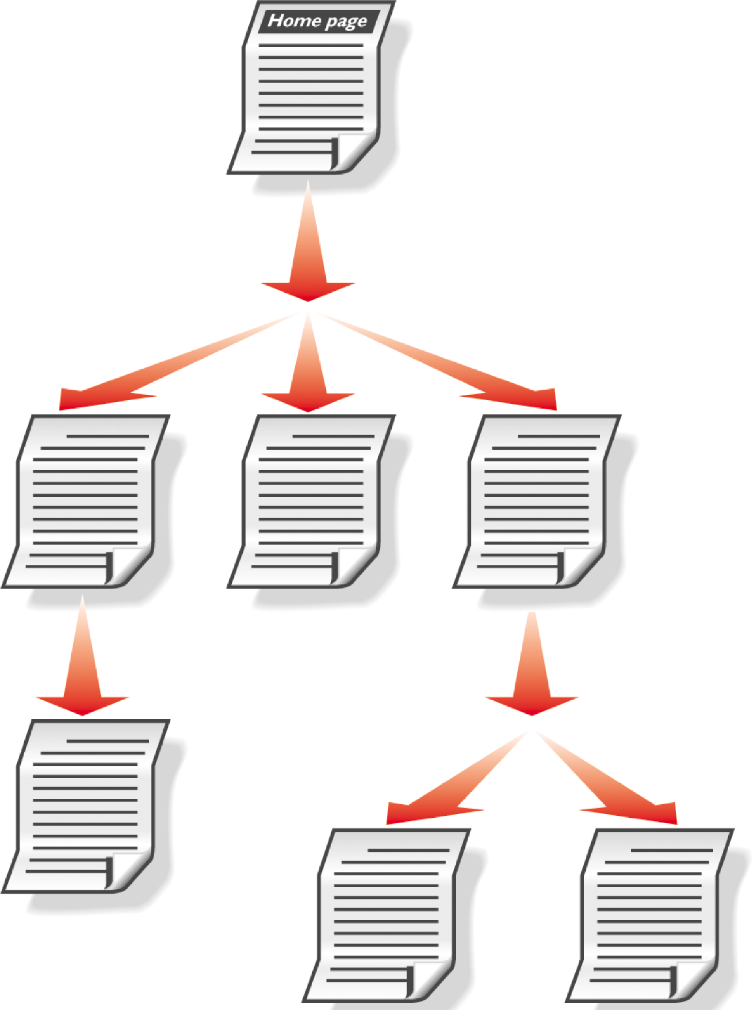
Web Site Design and Development
A hierarchical Web site structure connects Web pages in a tree-like structure

Slide 28
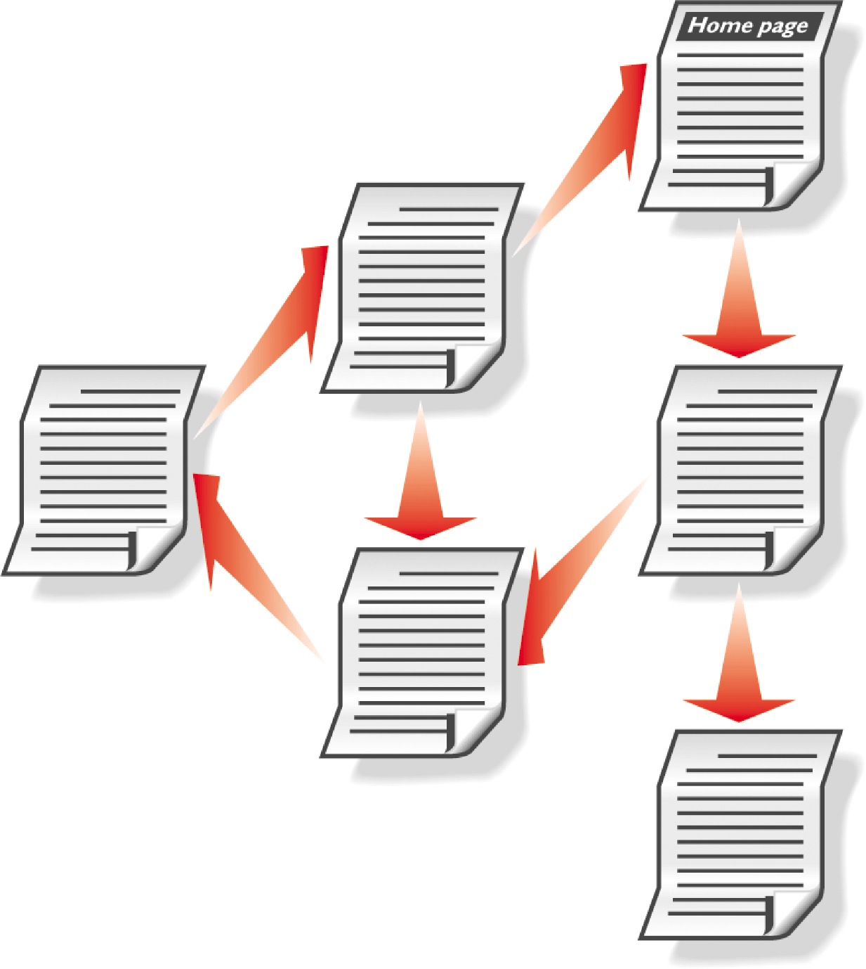
Web Site Design and Development
A webbed Web site structure has no set organization

Slide 29
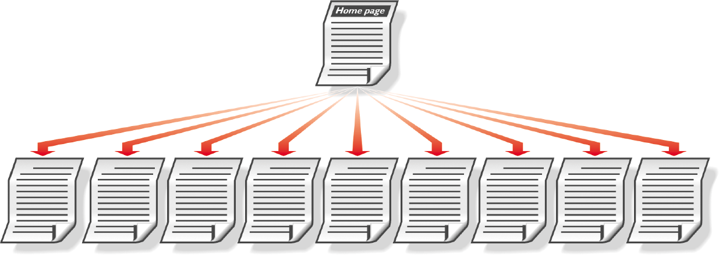
Web Site Design and Development
A broad Web site is one in which the home page is the main index page, and all other Web pages are linked individually to the home page

Slide 30
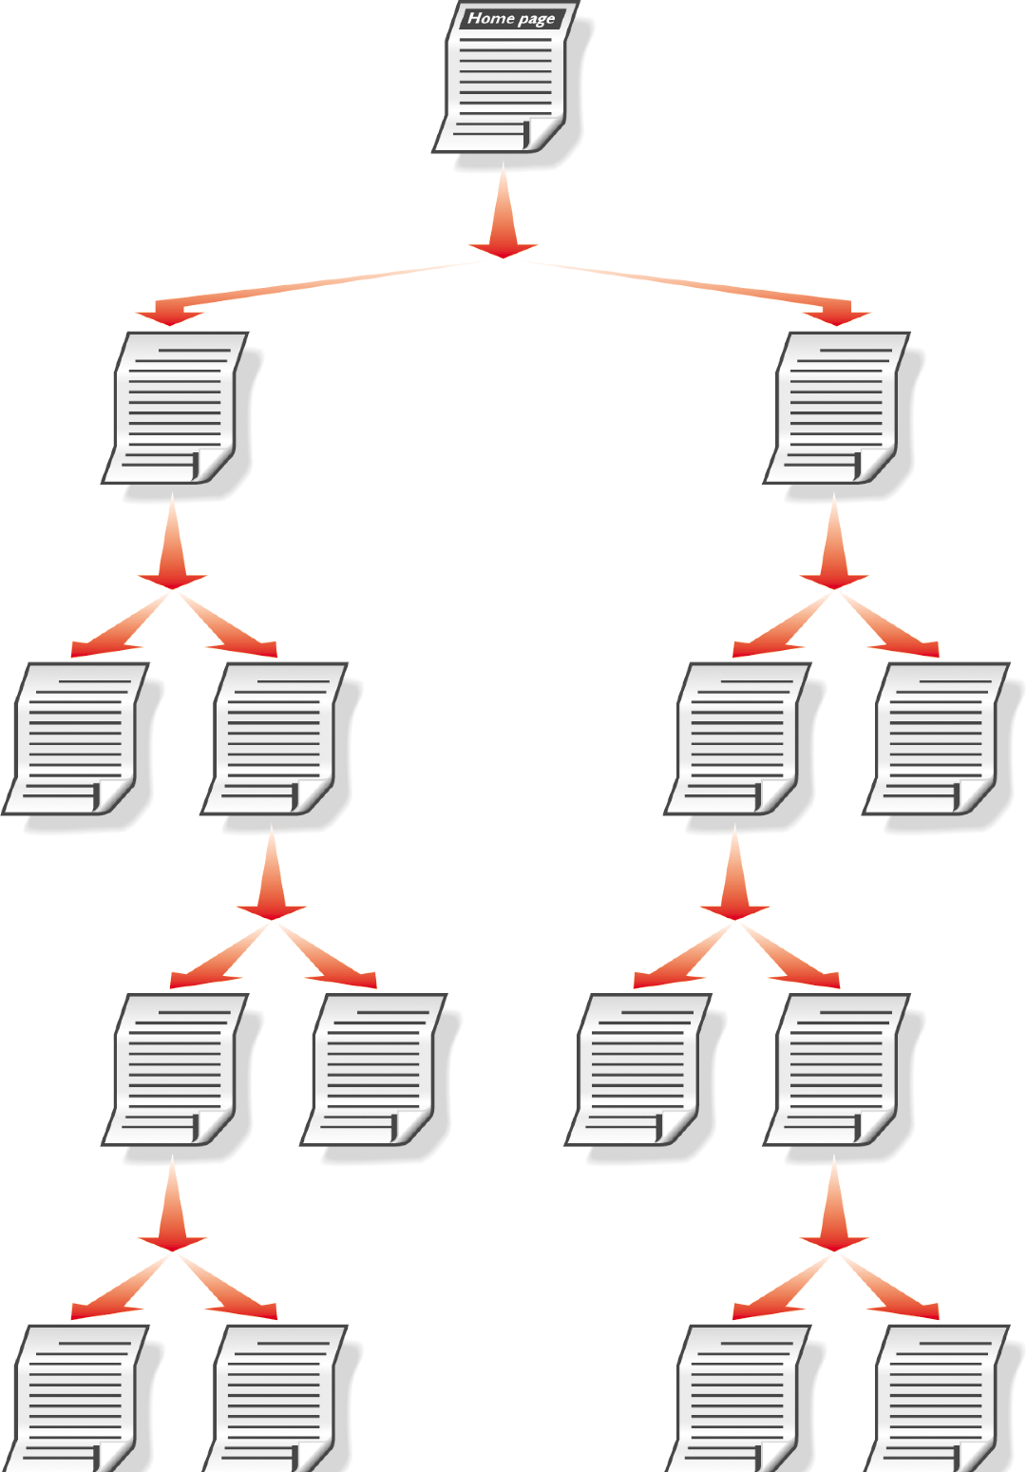
Web Site Design and Development
A deep Web site is one that has many levels of pages, requiring the user to click many times to reach a particular Web page

Slide 31
Web Site Testing
Usability is the measure of how well a product, such as a Web site, allows a user to accomplish his or her goals
Usability testing is a method by which users of a Web site or other product are asked to perform certain tasks in an effort to measure the product’s ease-of-use and the user’s perception of the experience

Slide 32
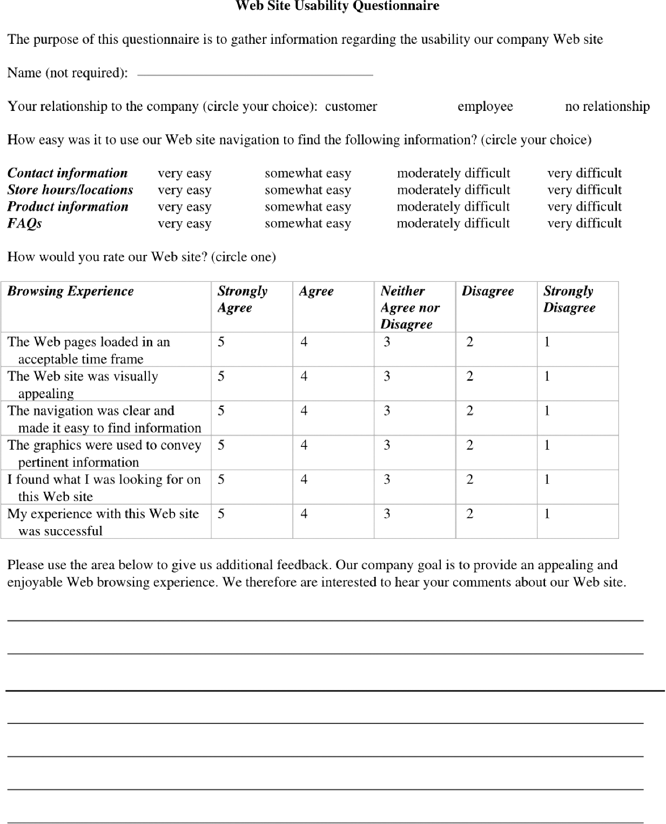
Web Site Testing Form

